Slide 1
Mise d’un fichier dans Hadoop
2012-01-01 09:00 San Jose Men's Clothing 214.05 Amex
2012-01-01 09:00 Fort Worth Women's Clothing 153.57 Visa
2012-01-01 09:00 San Diego Music 66.08 Cash
2012-01-01 09:00 Pittsburgh Pet Supplies 493.51 Discover
2012-01-01 09:00 Omaha Children's Clothing 235.63 MasterCard
2012-01-01 09:00 Stockton Men's Clothing 247.18 MasterCard

Slide 2
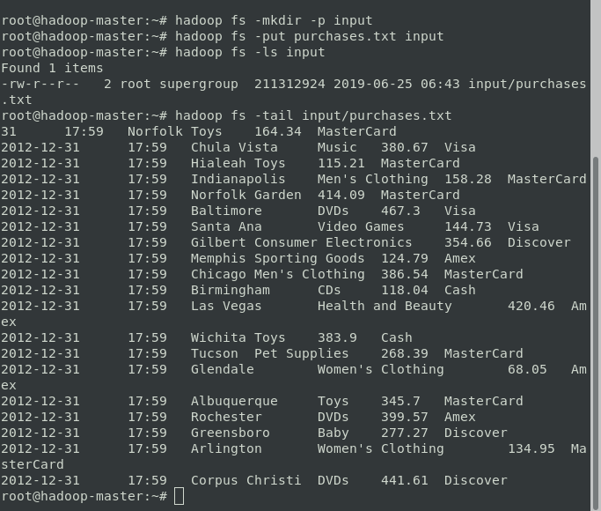

Slide 3
Spark et mapReduce

Slide 4
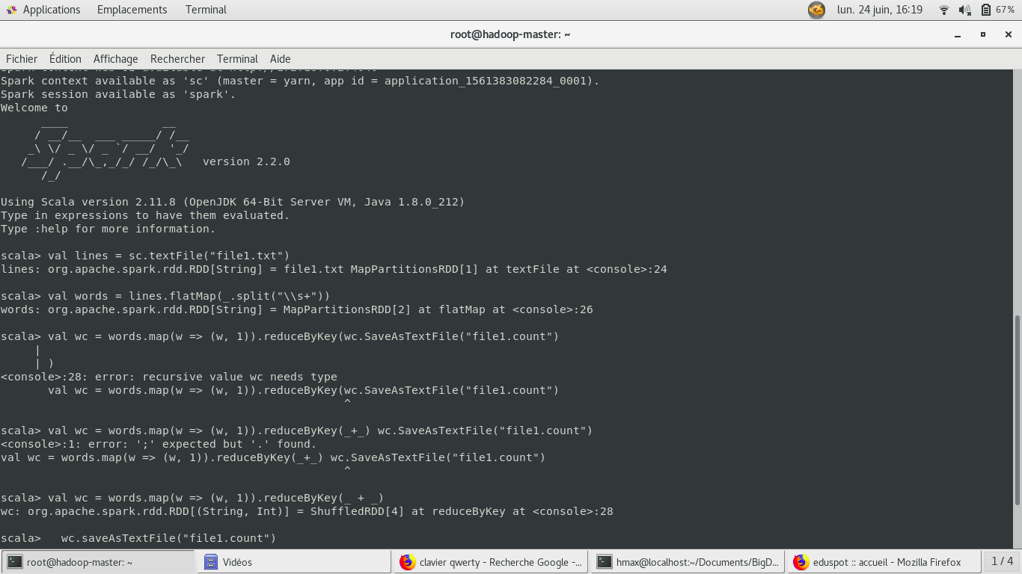

Slide 5
